Slide 1
UNIT 3: A PARTY A. READING

Slide 2
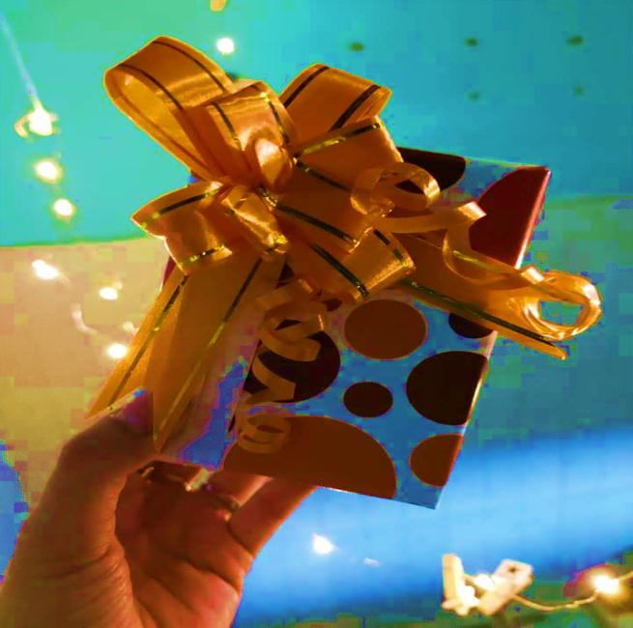
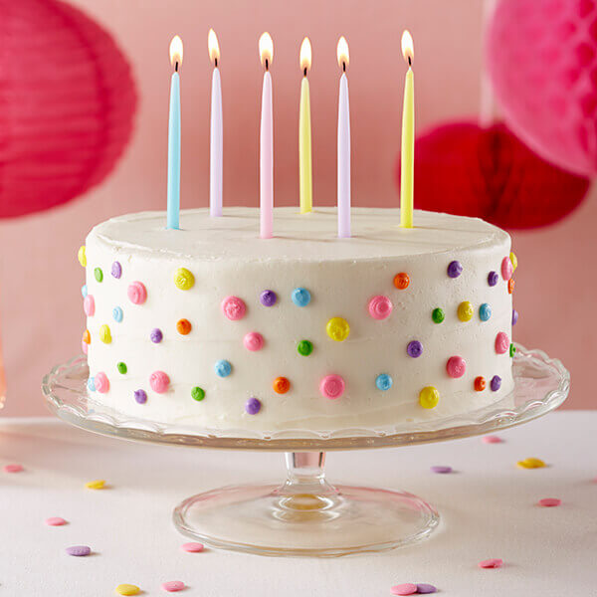
candle (n)
/ˈkændl/
birthday cake (n)
present (n)
/ˈbɜːθdeɪ keɪk/
/ˈpreznt/

Slide 3
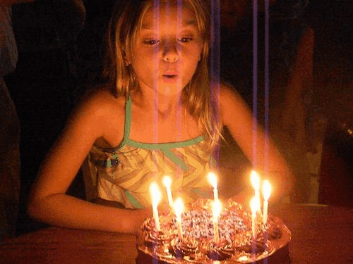
child (n)
adult (n)
/tʃaɪld/
/əˈdʌlt/
blow out (v)
/bləʊ aʊt/

Slide 4
Ex1: They seem like a very happy couple.
couple
(n)
/ˈkʌpl/
Ex2: Yesterday, they celebrated their 3th wedding anniversary.
celebrate
anniversary
(v)
/ˈselɪbreɪt/
(n)
/ænɪˈvɜːsəri/

Slide 5
milestone (n)
a very important stage or event in the development of something
/ˈmaɪlstəʊn/
Ex: My parents’ 25th wedding anniversary marked a milestone of a happy and lasting relationship.
joke (v)
say something to make people laugh
/dʒəʊk/

Slide 6
Unit 3: A PARTY
A. READING
I. New words
1. birthday cake (n) /ˈbɜːθdeɪ keɪk/ bánh sinh nhật
2. candle (n) /ˈkændl/ cây nến
3. present (n) /ˈpreznt/ quà tặng
4. adult (n) /əˈdʌlt/ người lớn
5. blow out (n) /bləʊ aʊt/ thổi tắt

Slide 7
6. couple (n) /ˈkʌpl/ cặp đôi
7. celebrate (v) /ˈselɪbreɪt/ làm lễ kỷ niệm
8. anniversary (n) /ænɪˈvɜːsəri/ lễ kỷ niệm
9. milestone (n) /ˈmaɪlstəʊn/ cột mốc
→ mark a milestone đánh dấu cột mốc
10. joke (v) /dʒəʊk/ nói đùa

Slide 8
A. It is Lisa’s birthday. She is seven years old today, and her family and friends are at her birthday party. On the table is a birthday cake with seven candles, one for each year. People sing ‘Happy Birthday’ to Lisa:
Happy birthday to you!
Happy birthday to you!
Happy birthday, dear Lisa!
Happy birthday to you!
When they finish singing, Lisa blows out the candles on the cake. Then everybody eats cake and ice cream. After that, Lisa opens her birthday cards and presents. Her family and friends give her toys and clothes for her birthday.
In the United States, people of all ages celebrate birthdays. But when an adult has a birthday, there are not a lot of candles on the birthday cake. Many Americans over the age of 30 don't like to talk about their age. Some people joke every year, “I’m 29 years old today.” Perhaps they do not want to be any older.
B. Rosa and Luis are having a party, too. But it is not a bidrthday party. It is an anniversary party. Fifty years ago, Rosa and Luis got married. Today their family and friends are giving them a party. Everyone eats some cake and says “Happy Anniversary!” to Rosa and Luis. People also give cards and gifts to the anniversary couple.
Most married couples in the United States celebrate wedding anniversaries each year. Husbands and wives give flowers or gifts to each other. They often have a quiet dinner at home or at a restaurant. They usually don’t have a big party.
But the 25th and the 50th wedding anniversaries are special. People call the 25th the “silver anniversary” and the 50th the “golden anniversary.” These anniversaries mark the milestones of a happy and lasting relationship between married couples. Rosa and Luis are happy to be together for their golden anniversary.

Slide 9
Task 1: Put a tick () in the right box.
 | BIRTHDAY PARTY | WEDDING ANNIVERSARY PARTY
1. People sing a song.

2. People eat cake.


3. People receive cards and gifts from friends and relatives.


4. People jokes about their age.

5. People remember their wedding day.

6. People go out to dinner.

7. People blow out candles, one for each year.


Slide 10
Task 2: Underline the WRONG word and correct it.
1. Lisa’s family and friends are at her eighth birthday party.
2. Everyone makes cakes and ice cream at the birthday party.
3. Lisa opens birthday cards and books from her family and friends.
4. Many Americans over the age of 30 don’t like to talk about their anniversaries.
5. Fifty months ago, Rosa and Luis got married.
6. People call the 5th wedding anniversary the “golden anniversary.”
7. Rosa and Luis are happy to be together for their silver anniversary.
7th
eats
presents
ages
years
50th
golden

